Slide 1

Diagnosis of Skin Cancer using Machine learning techniques

Slide 2
Content
Introduction
Skin Cancer Detection
Datasets (Malignant and Benign Skin Lesions)
Overview of Machine Learning Techniques
Algorithm
Block diagram
Deployment and Result
Code and Execution
Conclusion and Future Direction
References

Slide 3
Cancer is a disease which involves the atypical cell growth with the imminent to spread or enter into other parts of the body. Among the other cancers, harmful and dangerous form of cancer is the skin cancer.
More than twelve million people are suffering from cancer and the treatment to cure skin cancer remains the foremost tasks of modern medicine.
There are many steps involved in diagnosing the skin cancer such as pre-processing, image segmentation, feature extraction, feature deduction and classification. Each step involved in detecting the skin cancer and associated methods are discussed. For the classification Decision Tree, Random Forest Classifier, Logistic Regression are used.
Introduction

Slide 4
Economic Burden: The treatment of skin cancer imposes a significant financial burden on healthcare systems, with billions spent annually in the U.S. alone.
Shortage of Dermatologists: Many regions, especially rural and underserved areas, lack access to specialized dermatological care, leading to delays in diagnosis.
Time-Consuming Process: Traditional diagnostic procedures can be time-consuming, requiring multiple visits and biopsies.
Problem Statement

Slide 5
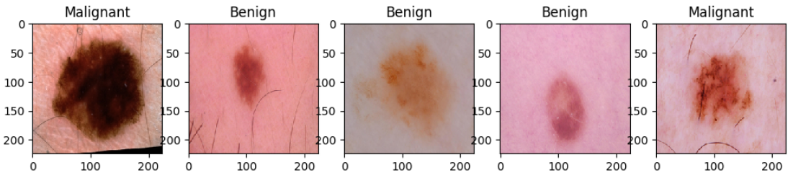
Understanding Malignant and Benign Skin Lesions
What is a malignant skin lesion?
What are benign skin lesions?
Skin lesions that are malignant are Skin Cancer. Skin cancer is the most common type of cancer in the US.
Signs of skin cancer include:
A wound that won’t heal.
New growth on skin.
Change in existing growth or mole.
Skin lesions that are benign are noncancerous and often harmless. These lesions are abnormal growths on your skin.
Examples of benign skin lesions include
Birthmarks
Moles

Slide 6
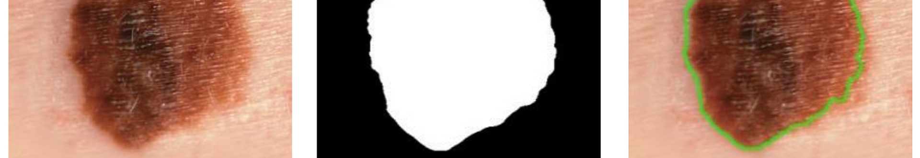



How Machine Learning Algorithms Can Be Used for Skin Cancer Detection
Data Analysis
Model Training
Diagnostic Tool
Analyze skin image data to extract features and classify into cancerous or non-cancerous.
Train the machine learning model using labeled skin image data to create an accurate classification system.
Implement the machine learning model as a diagnostic tool for early detection of skin cancer.

Slide 7
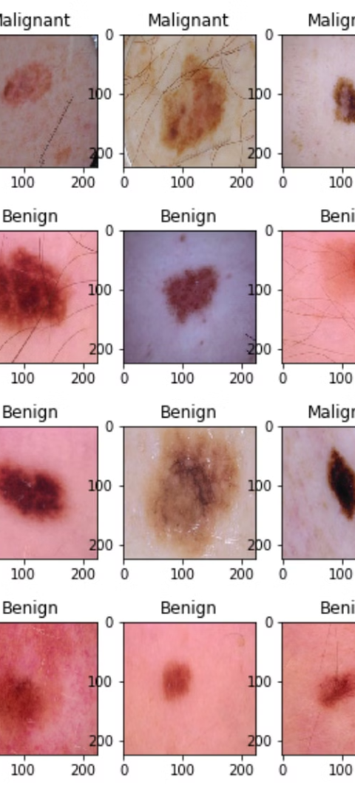
Data Collection and Preprocessing
1
Image Dataset
2
Quality Assurance
Gather a diverse and comprehensive dataset of skin images, including both cancerous and non-cancerous cases.
Ensure the accuracy and quality of data, including resolution, angle, and lighting conditions.
3
Preprocessing Steps
Clean, normalize, and prepare the dataset for model input, ensuring consistency and reliability.

Slide 8
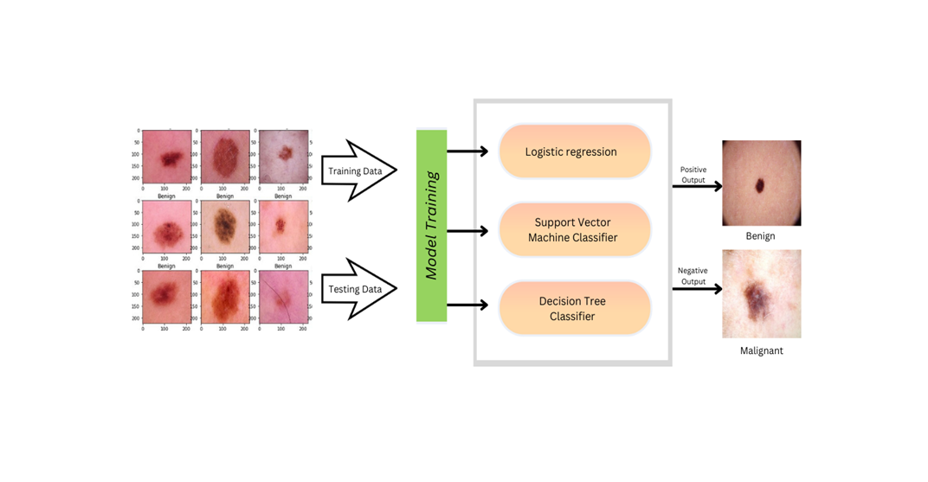
Architecture

Slide 9
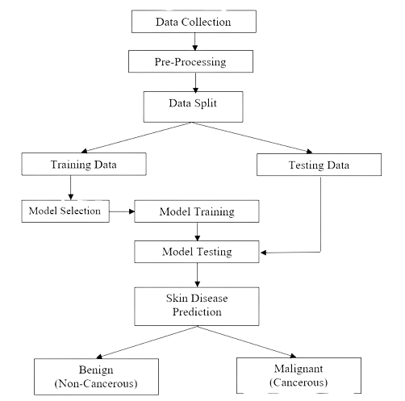
Block Diagram

Slide 10
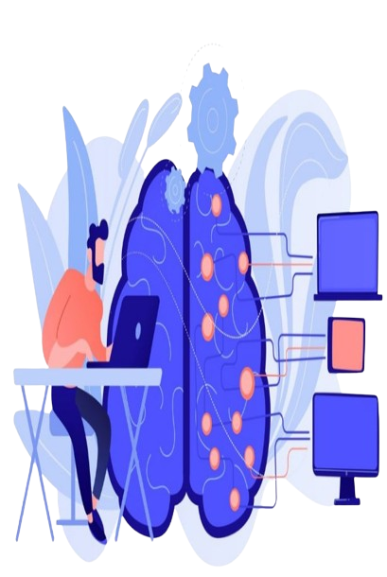
Machine Learning Technique
1
Logistic Regression
Random Forest Classifier
2
Decision Tree
3

Slide 11
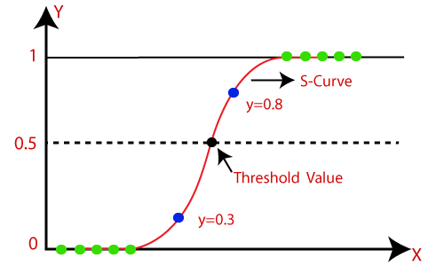
Logistic regression is one of the most popular Machine Learning algorithms, which comes under the Supervised Learning technique. It is used for predicting the categorical dependent variable using a given set of independent variables.
Logistic regression predicts the output of a categorical dependent variable. Therefore the outcome must be a categorical or discrete value. It can be either Yes or No, 0 or 1, true or False, etc. but instead of giving the exact value as 0 and 1, it gives the probabilistic values which lie between 0 and 1.
Algorithms
1
Logistic Regression:

Slide 12

Decision Tree is a Supervised learning technique that can be used for both classification and Regression problems, but mostly it is preferred for solving Classification problems. It is a tree-structured classifier, where internal nodes represent the features of a dataset, branches represent the decision rules and each leaf node represents the outcome.
In a Decision tree, there are two nodes, which are the Decision Node and Leaf Node. Decision nodes are used to make any decision and have multiple branches, whereas Leaf nodes are the output of those decisions and do not contain any further branches.
The decisions or the test are performed on the basis of features of the given dataset.
Algorithms
2
Decision Tree:

Slide 13
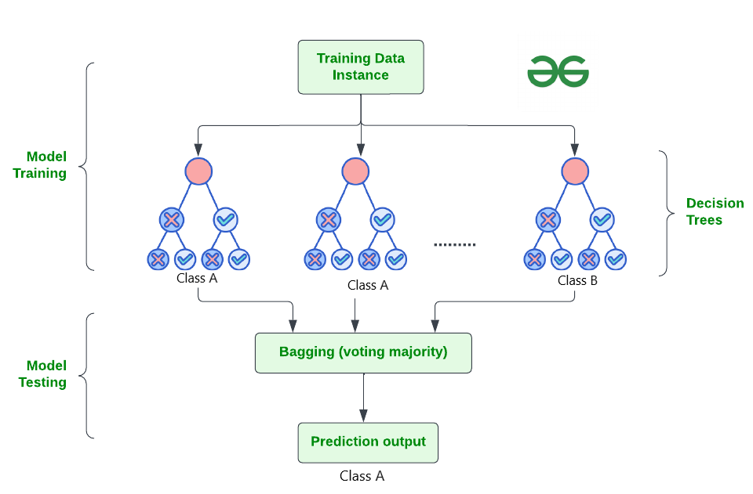
Random Forest algorithm is a powerful tree learning technique in Machine Learning. It works by creating a number of Decision Trees during the training phase. Each tree is constructed using a random subset of the data set to measure a random subset of features in each partition. This randomness introduces variability among individual trees, reducing the risk of overfitting and improving overall prediction performance. In prediction, the algorithm aggregates the results of all trees, either by voting (for classification tasks) or by averaging (for regression tasks) This collaborative decision-making process, supported by multiple trees with their insights, provides an example stable and precise results. Random forests are widely used for classification and regression functions.
Algorithms
3
Random Forest Classifier:

Slide 14
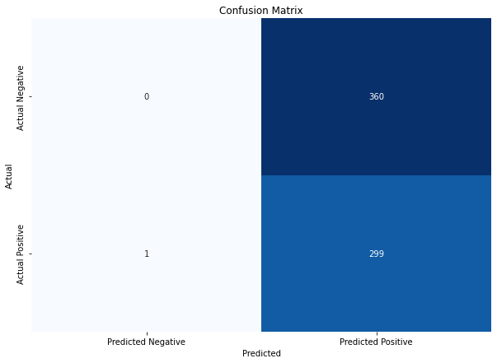
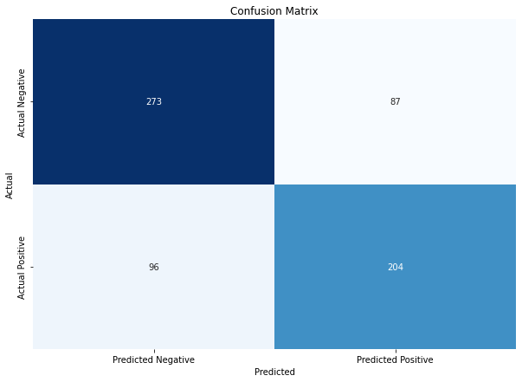
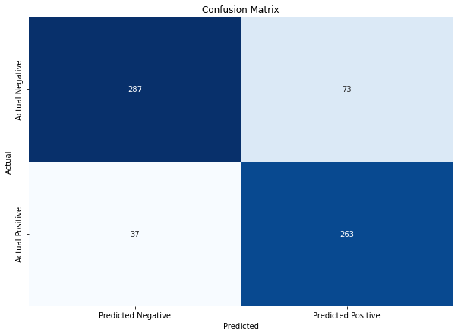
Performance comparison between Different Algorithms
Logistic Regression | Decision Tree | Random Forest
Confusion Matrix: | Confusion Matrix: | Confusion Matrix:
Accuracy: 14.35% | Accuracy: 72.2% | Accuracy:83%
Precision: 45% | Precision: 73.9% | Precision:88.5%
Recall: 99% | Recall: 75.8% | Recall: 79.7%
Specificity: - | Specificity: 68% | Specificity: 78.6%
F1 score: 62% | F1 score: 75.3% | F1 score: 83.9%

Slide 15
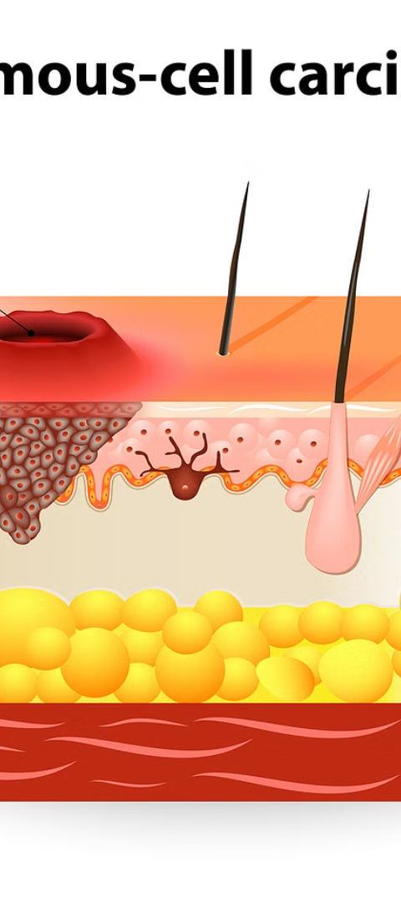
Conclusion
1
Impact and Continual Improvement
2
Accessibility and Scalability
Machine learning-based tools can be deployed on various platforms, including mobile devices and cloud services, making skin cancer screening accessible to a wider population, including those in remote or underserved areas.
Highlight the potential impact of Machine learning algorithm in skin cancer detection and suggest avenues for improvement.
3
Improved Diagnostic Accuracy:
Machine learning algorithms, especially deep learning models like CNNs, have demonstrated high accuracy in detecting and classifying skin cancer, often matching or surpassing human dermatologists.

Slide 16
Future Directions
1
Enhanced Accuracy and Robustness
2
Integration with Wearable Technology
The integration of skin cancer detection algorithms with wearable technology, such as smartwatches or portable scanners, could facilitate continuous monitoring and early detection of skin abnormalities
Continued research and development in machine learning algorithms can lead to even more accurate and robust models for skin cancer detection.
3
Real-Time Detection and Diagnosis
Developing real-time detection systems can provide instant feedback during medical examinations, aiding dermatologists in making quicker and more informed decisions.

Slide 17
References
https://www.sciencedirect.com/science/article/pii/S0141933120308723
https://ieeexplore.ieee.org/stamp/stamp.jsp?tp=&arnumber=8257738&tag=1
https://ictactjournals.in/paper/IJSC_Vol_11_Iss_2_Paper_9_2301_2305.pdf
https://www.irjet.net/archives/V4/i7/IRJET-V4I7609.pdf

Slide 18
Thank You!!

